Slide 1
MSSP 608: Practical Machine Learning Methods Week 4
1

Slide 2
House Keeping
Quiz due tomorrow (before midnight)
Piazza – set it up
Homework 1 posted. Due date in syllabus. Will post help tomorrow.
Any questions?

Slide 3
READINGS
https://towardsdatascience.com/11-most-common-machine-learning-algorithms-explained-in-a-nutshell-cc6e98df93be
https://towardsdatascience.com/feature-selection-using-regularisation-a3678b71e499
***PLEASE READ BEFORE CLASS / do not focus on math***

Slide 4
Road Map…
Validation | ML Algorithms
 | Supervised | Unsupervised | Reinforcement
None | Decision trees | Prin. Comp. Anal. (PCA)
Test/train | Linear regression | K-means
Feature selection / regularization | Logistic regression | Hierarchical clustering
K-fold test/train | Naïve Bayes
Hyperparameter tuning | Random Forests
 | Gradient Boosting
 | SVM algorithm
 | kNN
Prior weeks
This week
Next week
Coming weeks

Slide 5
Quiz #1 and #2
5

Slide 6
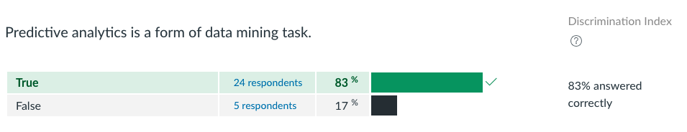
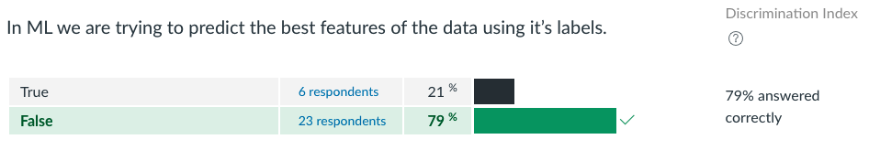
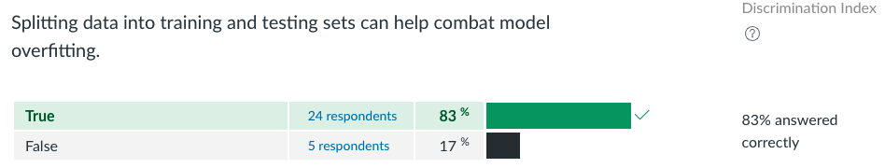
Quiz 1 (1)

Slide 7
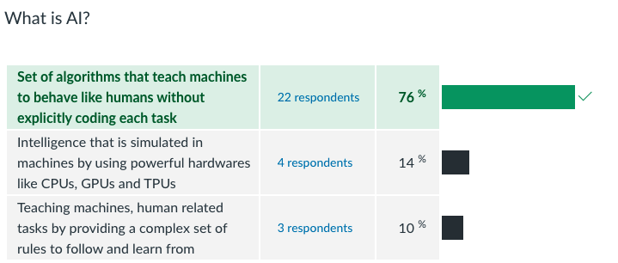
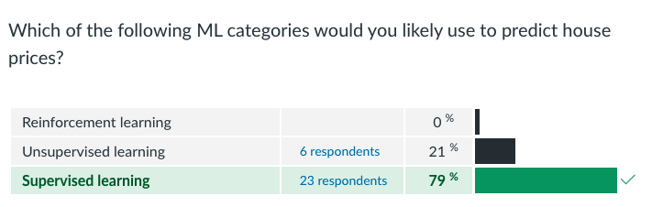
Quiz 1 (2)

Slide 8
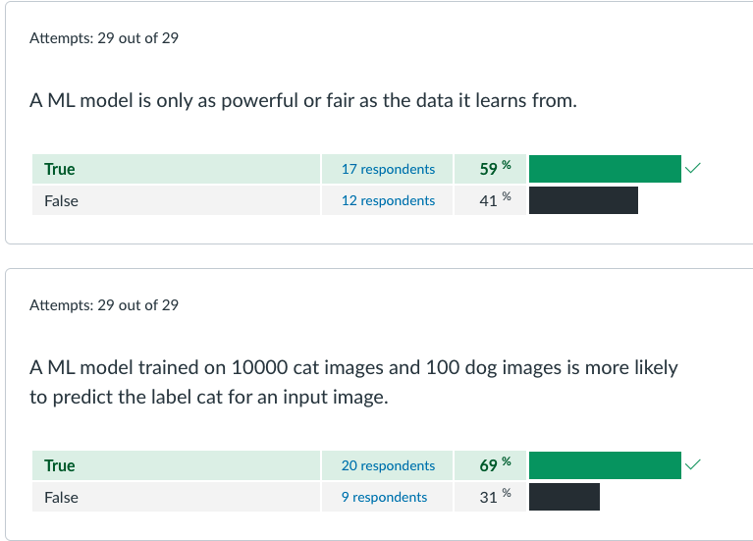
Quiz 1 (3)

Slide 9
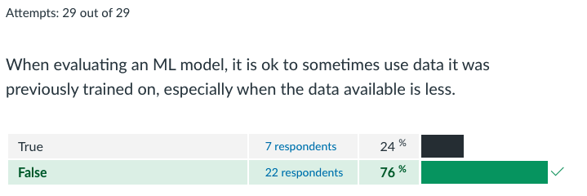
Quiz 1 (4)

Slide 10
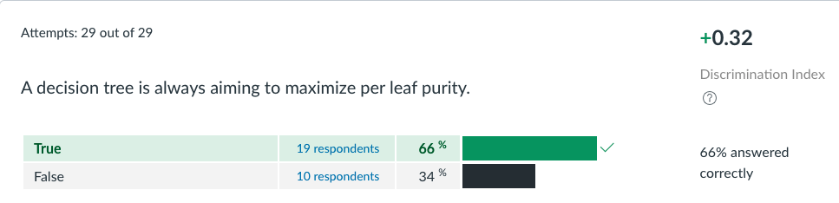
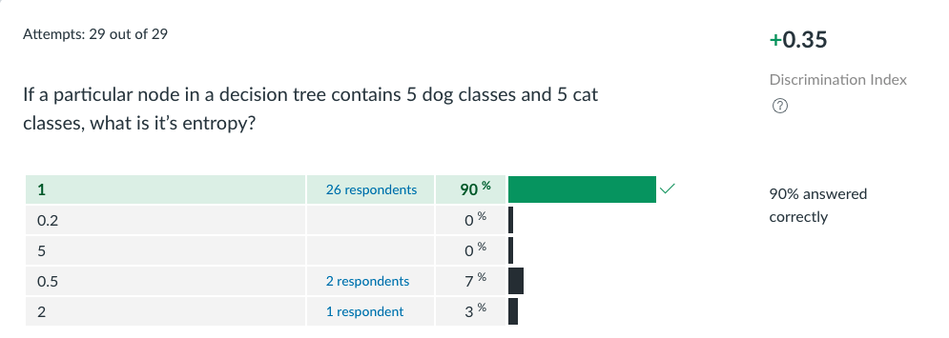
Quiz 2 (1)

Slide 11
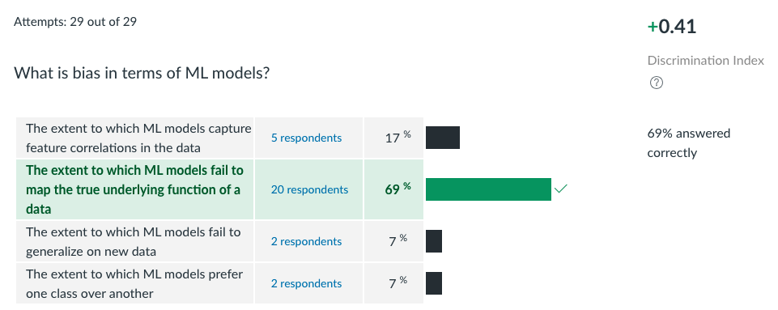
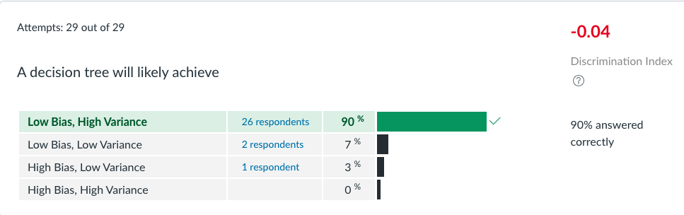
Quiz 2 (2)

Slide 12
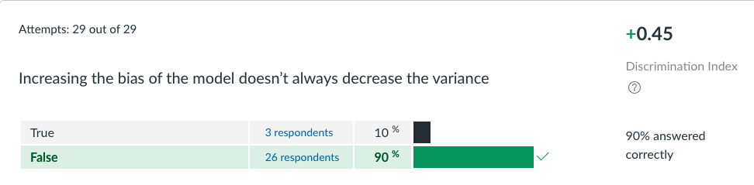
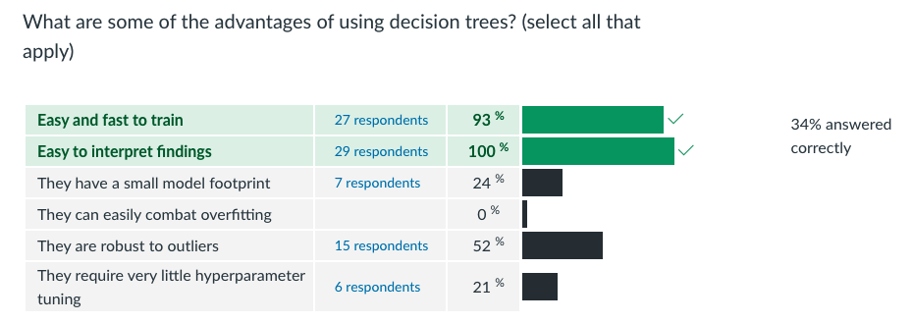
Quiz 2 (3)

Slide 13
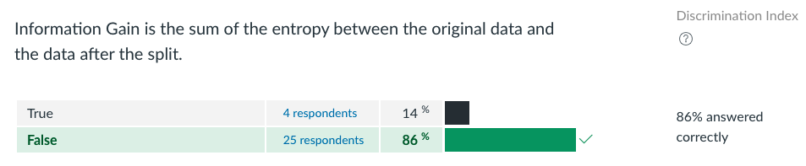
Quiz 2 (4)

Slide 14
Review (test/train data)
14

Slide 15
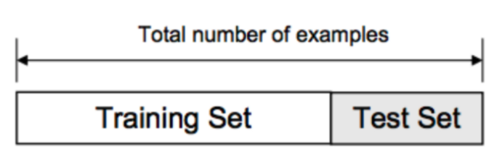
Training/Test Split
The training set contains a known output, and the model learns on this data in order to be generalized to other data later
We have the test dataset (or subset) in order to test our model’s prediction on this subset
https://www.youtube.com/watch?v=Zi-0rlM4RDs&t=358s

Slide 16
PYTHON (WITH TEST/TRAIN)
X = bikeshare.loc[:, weather_features]
X = pd.get_dummies(X)
y = bikeshare["high_traffic"]
# Use scikit-learn to create our train/test split and train our decision tree
X_train, X_test, y_train, y_test = train_test_split(X,y,test_size=0.20, random_state=123)
model = DecisionTreeClassifier(criterion="entropy", random_state=123).fit(X_train, y_train)
# Calculate our accuracy on the train and test sets
train_pred = model.predict(X_train)
train_accuracy = 100*accuracy_score(y_train, train_pred)
test_pred = model.predict(X_test)
test_accuracy = 100*accuracy_score(y_test, test_pred)

Slide 17
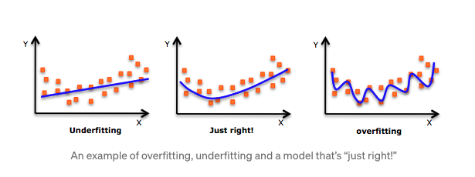
https://www.youtube.com/watch?v=Anq4PgdASsc

Slide 18
Road Map…
Validation | ML Algorithms
 | Supervised | Unsupervised | Reinforcement
None | Decision trees | Prin. Comp. Anal. (PCA)
Test/train | Linear regression | K-means
Feature selection / regularization | Logistic regression | Hierarchical clustering
K-fold test/train | Naïve Bayes
Hyperparameter tuning | Random Forests
 | Gradient Boosting
 | SVM algorithm
 | kNN
Prior weeks
This week
Next week
Coming weeks

Slide 19
Objectives
Logistic regression
Linear regression

Slide 20
Logistic Regression

Slide 21
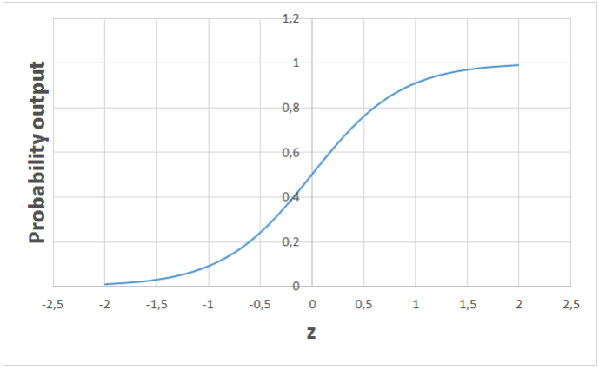
Logistic Regression
Supervised learning algorithm
Binary classification problems (0 or 1 – e.g., pass or fail, healthy or sick)
High bias / low variance
Takes in any real valued number and maps it to a value between 0 and 1

Slide 22
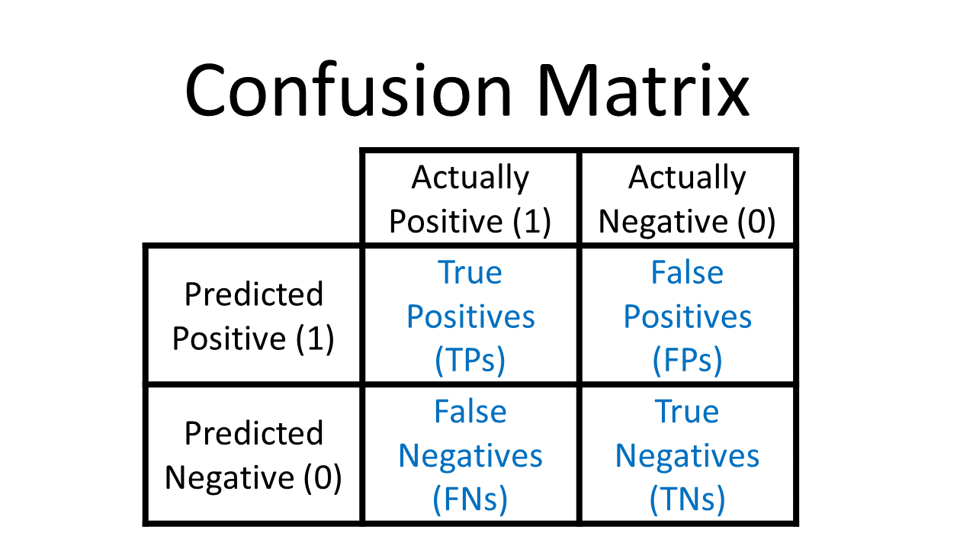
Logistic Regression
In the context of rapid COVID testing, why is this so critical?

Slide 23
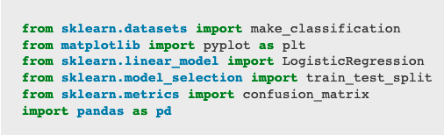
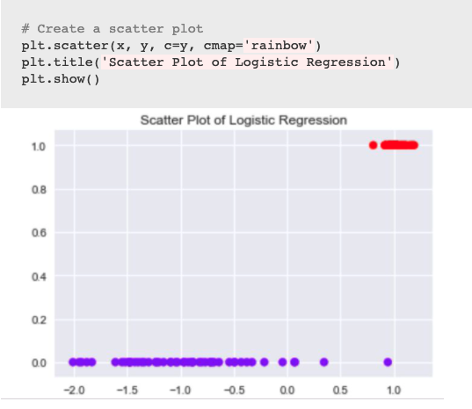
Logistic Regression
Import packages:
Visualize data:

Slide 24

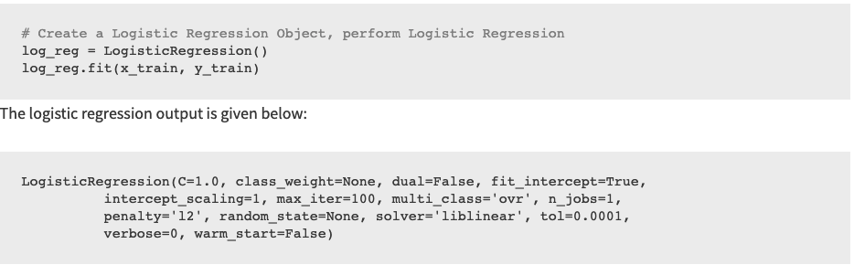
Logistic Regression
Split data:
Perform logistic regression:

Slide 25

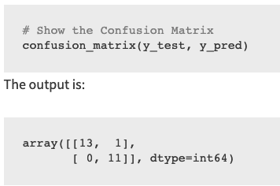
Logistic Regression
Make predictions using model:
Display confusion matrix:

Slide 26
Linear Regression

Slide 27
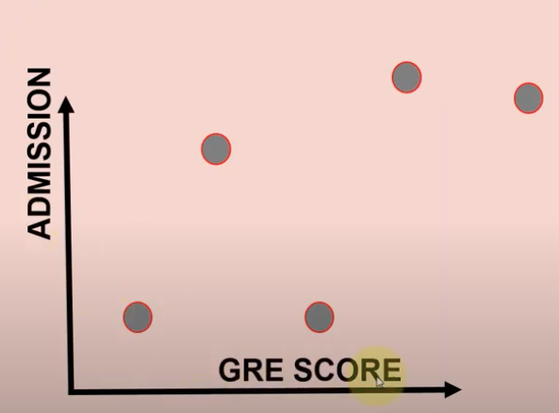
Linear Regression
Supervised learning algorithm
Assumes a linear relationship
High bias / low variance

Slide 28
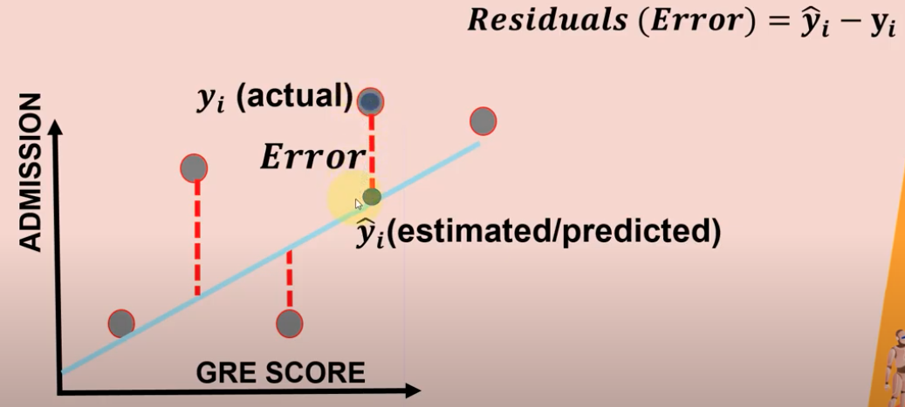
Key metrics
Mean Absolute Error (MAE)
Mean Squared Error (MSE)
Root Mean Squared Error (RMSE)
Coefficient of determination (R squared)

Slide 29
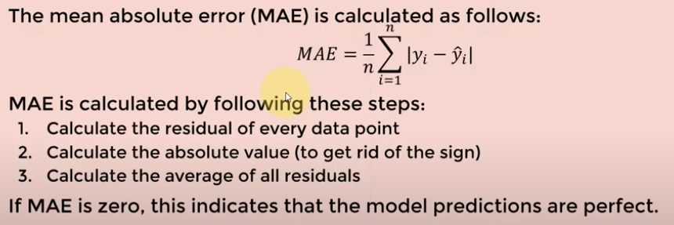
MAE (1)

Slide 30
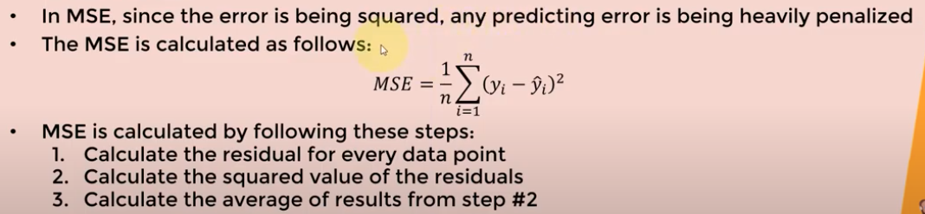
MSE (2)

Slide 31
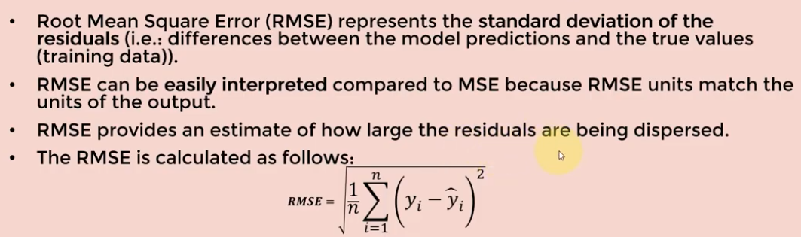
RMSE (3)

Slide 32
R-squared (4)
“Goodness of fit”
Proportion of variance (of y) that has been explained by the independent variables in the model.
Best possible score is 1.0 (ranges from 0 to 1)
If 𝑅2=0.8, this means that 80% of the increase in university admission is due to GRE score (assuming a simple linear regression model).

Slide 33
Example
from sklearn.model_selection import train_test_split
X_train, X_test, Y_train, Y_test = train_test_split(X, Y, test_size=0.2)
from sklearn import linear_model
from sklearn.metrics import mean_squared_error, r2_score
model = linear_model.LinearRegression()
model.fit(X_train, Y_train)
Y_pred = model.predict(X_test)
print('Coefficients:', model.coef_)
print('Intercept:', model.intercept_)
print('Mean squared error (MSE): %.2f’
% mean_squared_error(Y_test, Y_pred))
print('Coefficient of determination (R^2): %.2f’
% r2_score(Y_test, Y_pred))
coefficients: [2.0] (a one unit increate in GRE score is associated with a 2 percent increase in admission rates)
Intercept: 33.890629034122
Mean squared error (MSE): 26.54
Coefficient of determination (R^2): 0.71

